Slide 1

Magnetismo
(experimental)
Yutao Xing
Instituto de Física, Universidade Federal Fluminense
Notes:
1

Slide 2
PARTE TEORIA (PROF. Daniel Rocco)
Paramagnetismo
Diamagnetismo
Ferromagnetismo
Antiferromagnetismo
Ferrimagnetismo
Superparamagnetismo

Slide 3

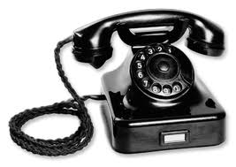

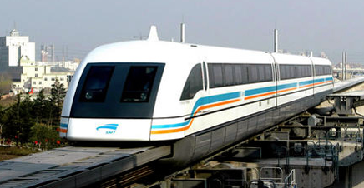
Parte experimental
Magnetismo conectado conosco
3
Notes:
3

Slide 4
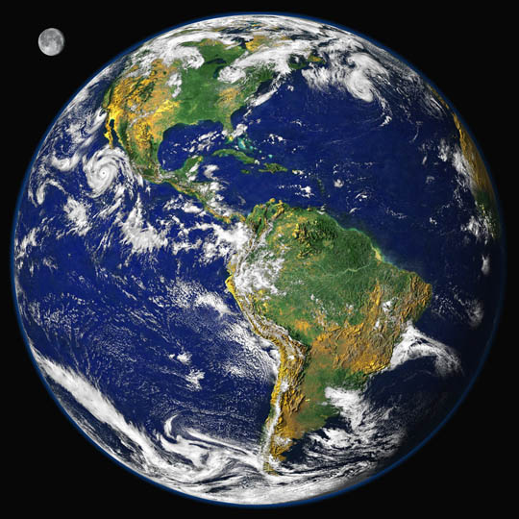
Pode escapar de magnetismo?
PÓLO NORTE
PÓLO SUL
4
Notes:
4

Slide 5
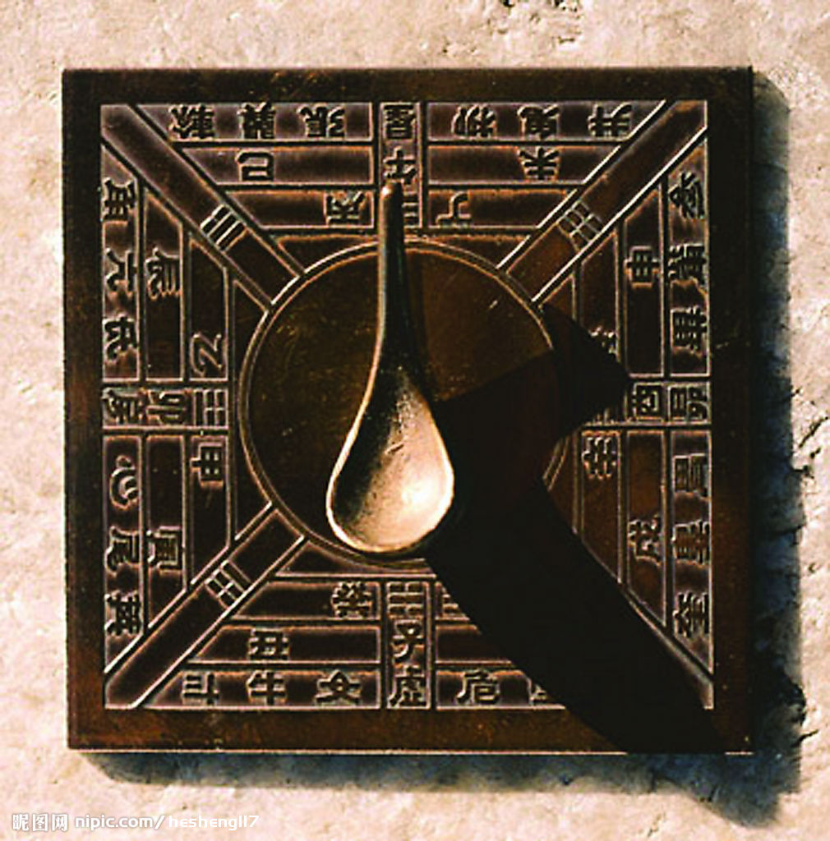

Utilização do campo de terra
bússola
5
Notes:
5

Slide 6
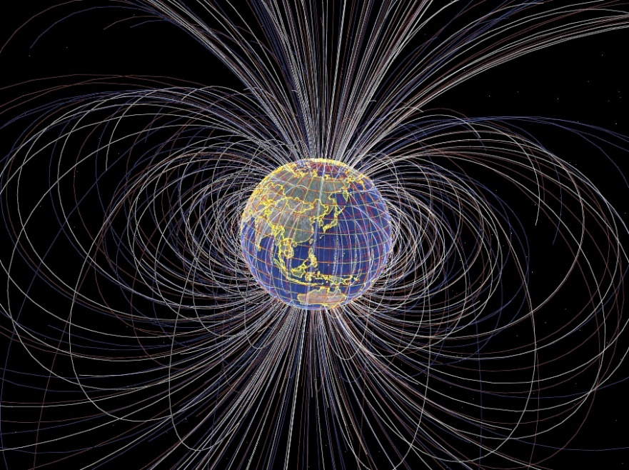
Como ela funciona?
Interação entre imã e campo magnético:
A
A
6
Notes:
6

Slide 7
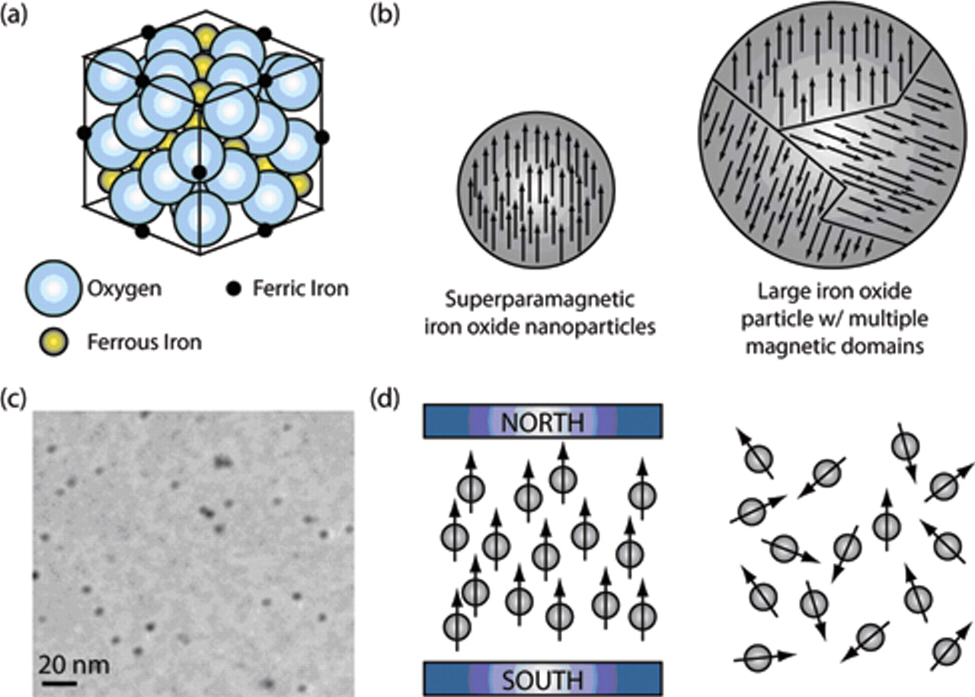
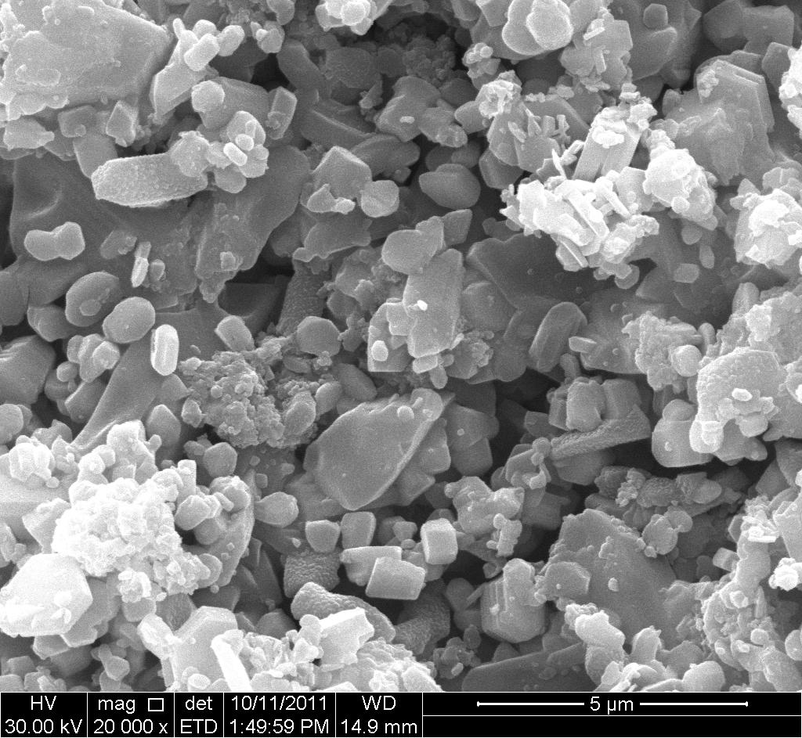
Interação: imã e ferro
Por que tem interação entre imã e ferro?
Domínio !
7
Notes:
7

Slide 8
Interação: imã e ferro
Perguntas:
Por que não tem interação entre imã e cobre?
Por que a imã na porta de geladeira não cai?
8
Notes:
8

Slide 9
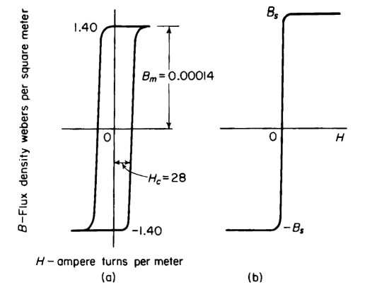
Material ferromagnética:
Material magnética dura:
NdFeB
Material magnética macia:
FeNi
Pergunta: Qual é diferença magnética entre FeNi e Cu?
9
Notes:
9

Slide 10
Material ferromagnética:
Por que depois de tirar o campo, os momentos magnéticos não voltam para direção e sentido anterior?
Anisotropia:
Anisotropia cristalina
Anisotropia de forma
10
Notes:
10

Slide 11
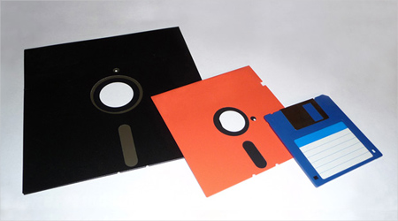
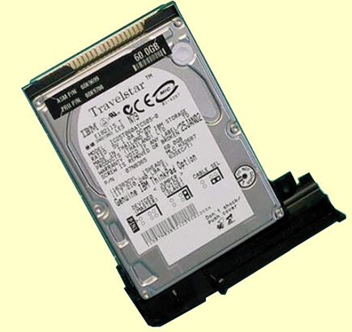
Utilização dos domínios
11
Notes:
11

Slide 12
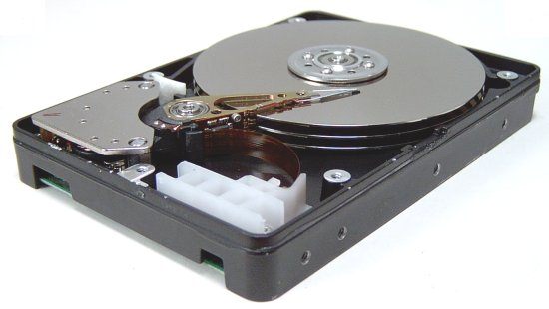
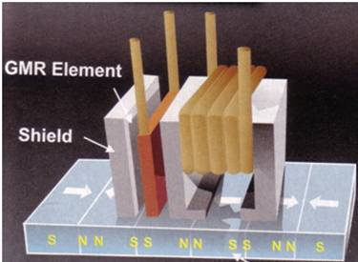
Utilização dos domínios
12
Notes:
12

Slide 13
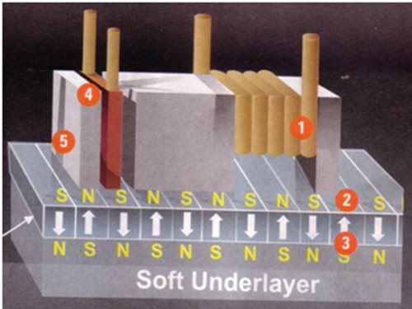
Utilização dos domínios
13
Notes:
13

Slide 14
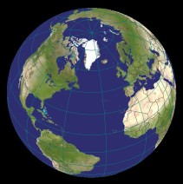

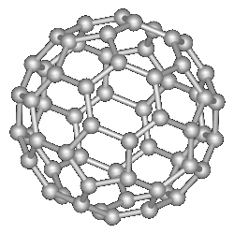
Nanomagnetismo: uma nova era
O que é nano? 1nm = 1x 10⁻⁹ m Diâmetro de cabelo: 70 µm = 70 000 nm
ww.mathworks.com
Fullerenes C₆₀
www.physics.ucr.edu
12,756 Km
22 cm
0.7 nm
1.27 × 10⁷ m
0.22 m
0.7 × 10⁻⁹ m
10 millions times smaller
1 billion times smaller

Slide 15
Nanomagnetismo: uma nova era
Nano Material:
0D: nanopartículas
1D: nanofios (nanotubo de carbono)
2D: filme finos
3D: materiais nanocristalinas.
15
Notes:
15

Slide 16
Nanomagnetismo: as diferenças
Surface effect
  Dimension
Fraction of surface
number of surface atoms > number of core atoms
Size comparable to quantum mechanical length scales
  e.g. mean free path, coherence length, etc.
  quantum effects
Number of atoms is limited
no classical thermodynamics
16
Notes:
16

Slide 17

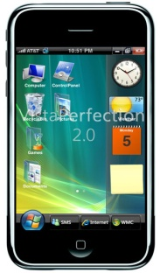
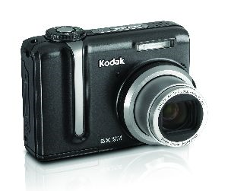
New physics phenomena I
Giant magnetoresistance (GMR)
2007 Nobel prize
Wide applications:
17
Notes:
This is nano multilayres thickness is close to the lamda as I mentioned. Another example is the spin torque effect
17

Slide 18
New physics phenomena I
Question:
Why other people did not discover GMR before these two researchers since many people were doing research with thin films?
Answer:
Dimensions!
  Thickness of the thin films < mean free path of the free electrons
18
Notes:
18

Slide 19
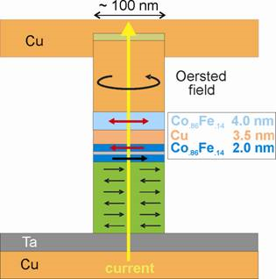
New physics phenomena II
Spin torque effect
Magnetic moment can be flipped by spin-polarized current.
19
Notes:
The third example I would like to give is the study of carbon nanotubes
19

Slide 20
New physics phenomena II
Spin torque effect
Question:
Why other people did not discover STE before?
Answer:
Dimensions!
Very high Current density!!
Only with very good e-beam lithography can they make the sample !
20
Notes:
The third example I would like to give is the study of carbon nanotubes
20

Slide 21
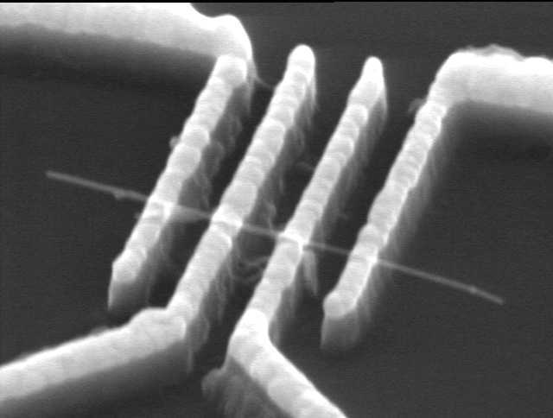
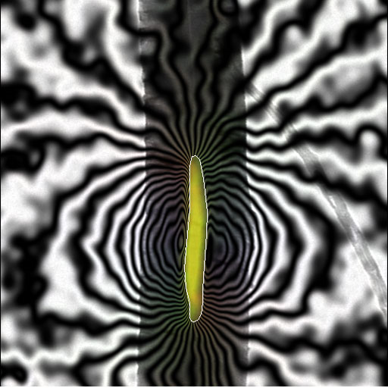
New physics phenomena III
Carbon nanotubes
Single domain Fe particle inside !
With nano contacts, transport properties of a single carbon nanotube can be studied.
Carbon nanotube can be aligned by external magnetic field.
From Prof. Paul Midgley, Cambridge
21
Notes:
Because the nanosience is so interesting, the researchers are trying different methods to make nano scaled materials
21

Slide 22
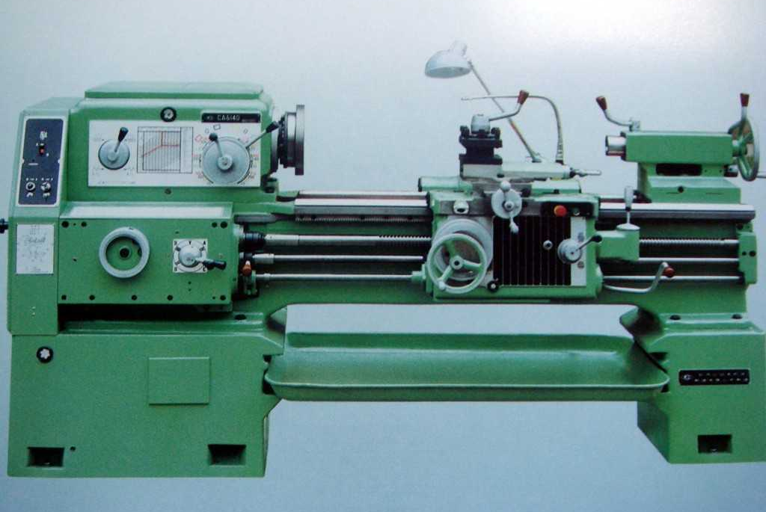
How to prepare nano-scaled materials?
?
22
Notes:
These are the methods to prepare the nano materials. For the research of physics, I would like to focus on the following topics,
22

Slide 23
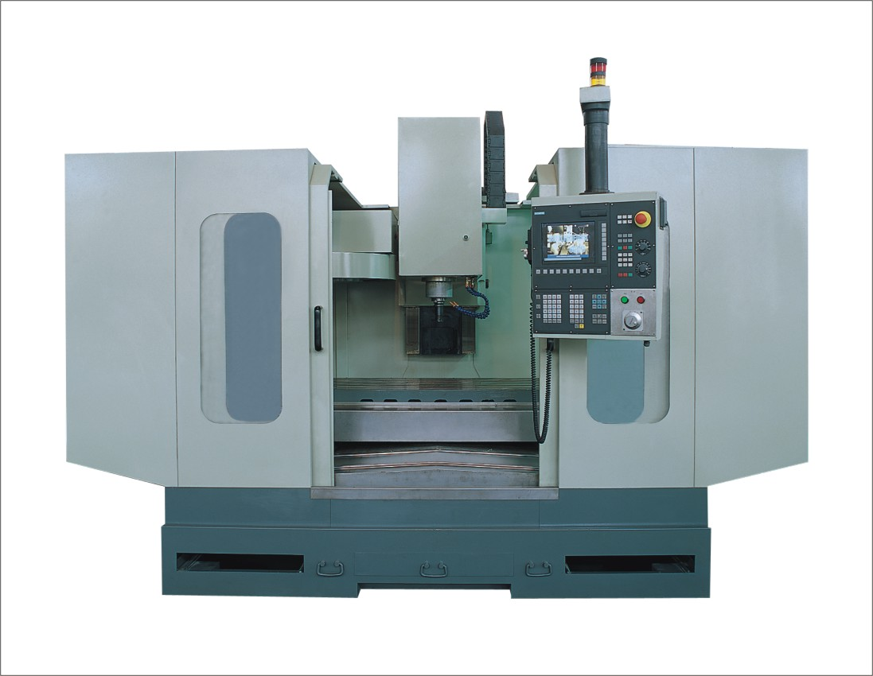
How to prepare nano-scaled materials?
?
23
Notes:
These are the methods to prepare the nano materials. For the research of physics, I would like to focus on the following topics,
23

Slide 24
How to prepare nano-scaled materials?
Filme finos:
Técnicas de deposição:
Sputtering
MBE
Ablação por laser
......
Nano partículas:
Método química
Método física
......
24
Notes:
These are the methods to prepare the nano materials. For the research of physics, I would like to focus on the following topics,
24

Slide 25
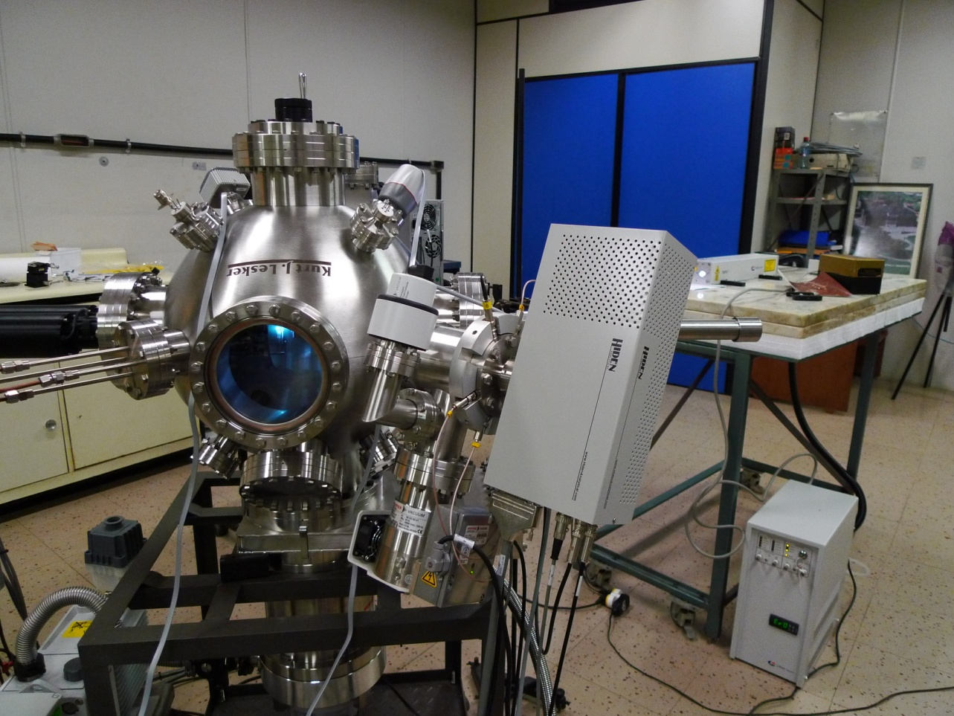
How to prepare nano-scaled materials?
Ablação por laser
25
Notes:
These are the methods to prepare the nano materials. For the research of physics, I would like to focus on the following topics,
25

Slide 26
Introduction to the system
Installed in 2011
Base pressure: 4 x 10⁻⁷ Torr
(Pressure can be reached in one hour)
Power of laser: 500 mJ
Pulse of laser: 10 pulses/second
Notes:
we can find the IV curves seperated into two different groups: above Tg and below Tg. With the above data ,we can not conclude that the spontaneous vortices are related with the Co nanoparticles in the sample, In order to clarify this doutb, we did the following experiments:

Slide 27
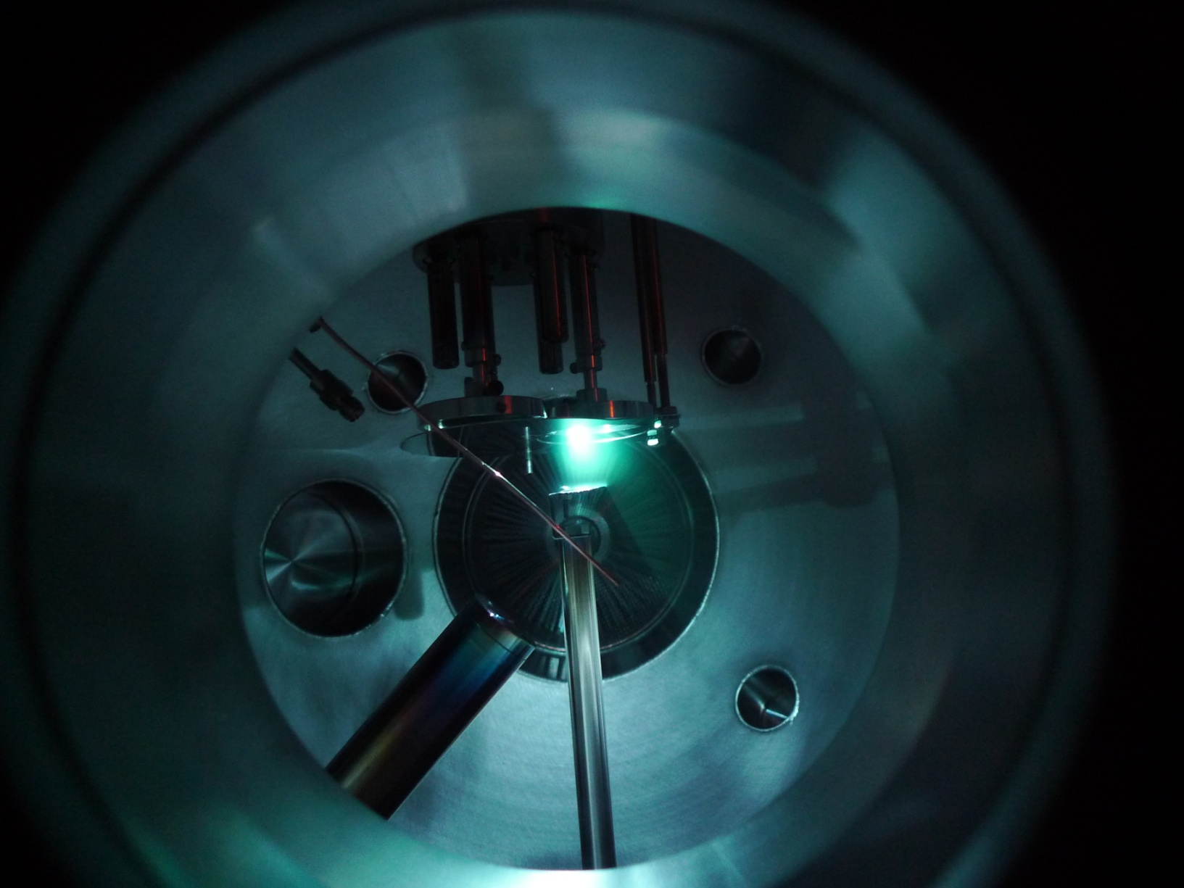
Plasma of Ni

Slide 28
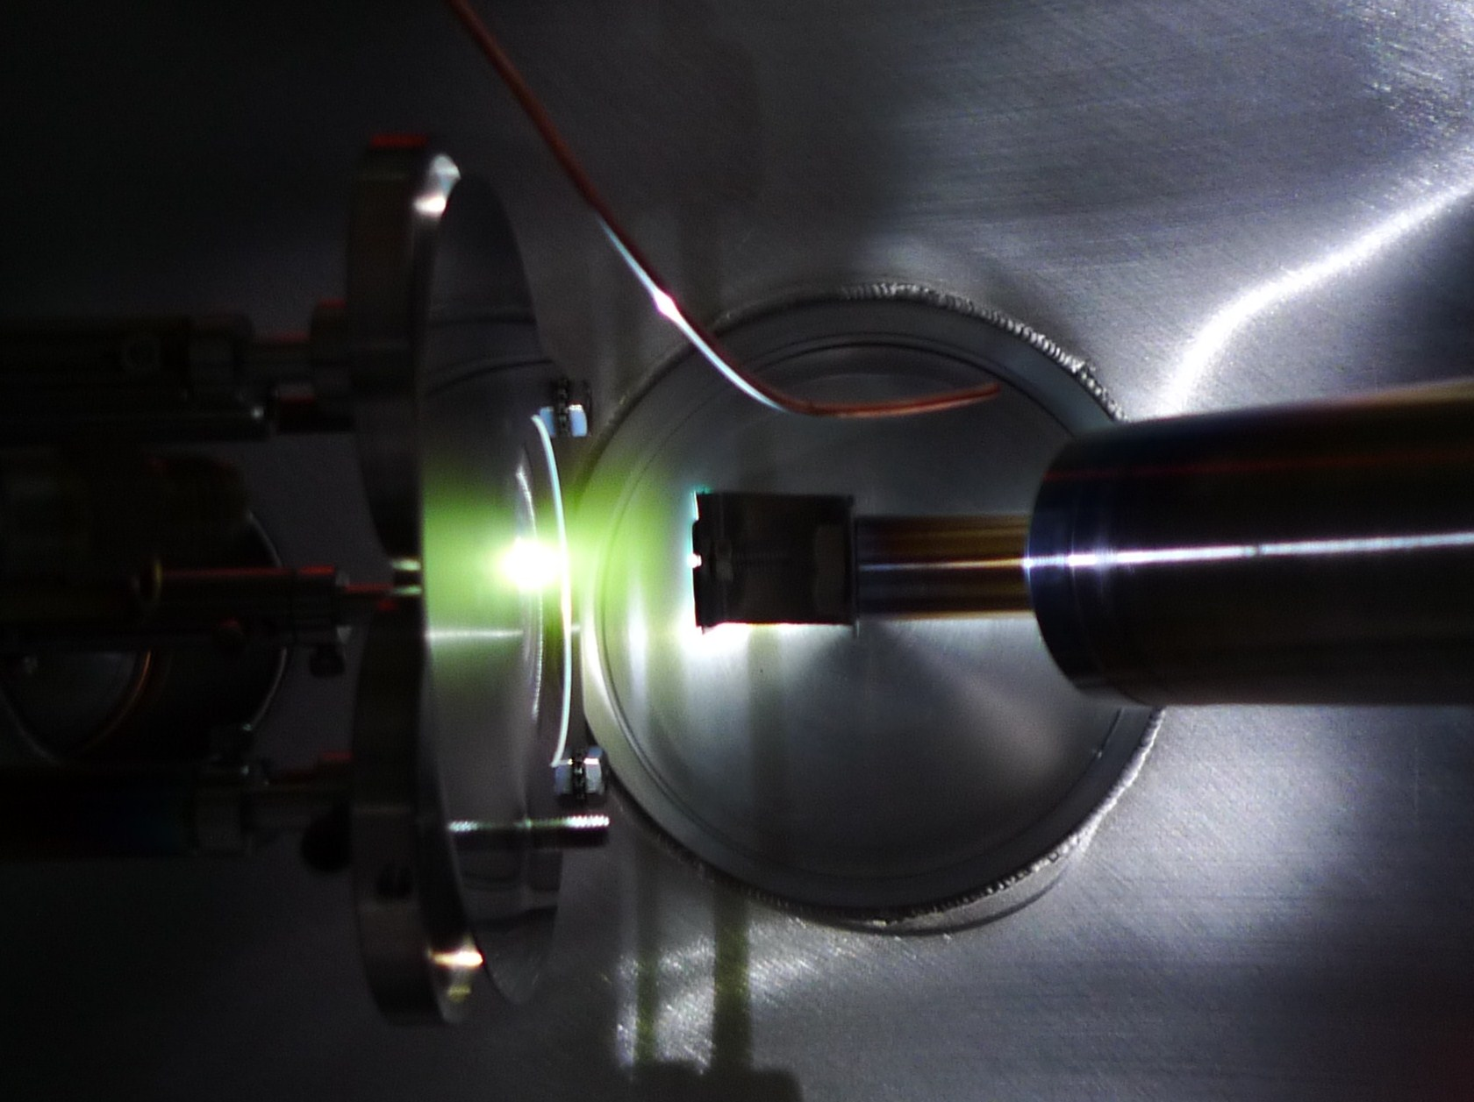
Plasma of Tin

Slide 29
Sample preparation
Thin films: in vacuum
Nanoparticles: in Ar with a pressure of 1 torr

Slide 30
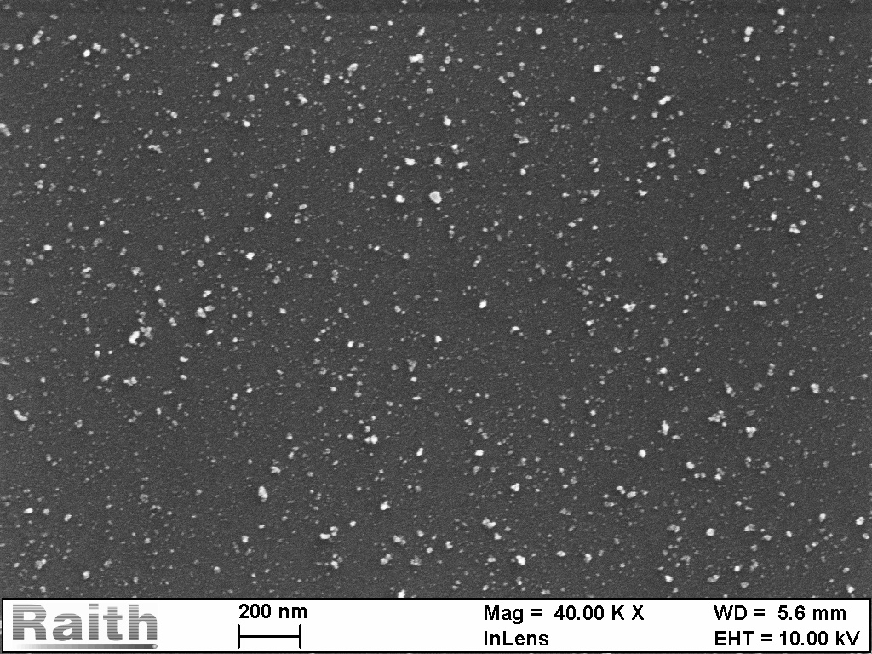
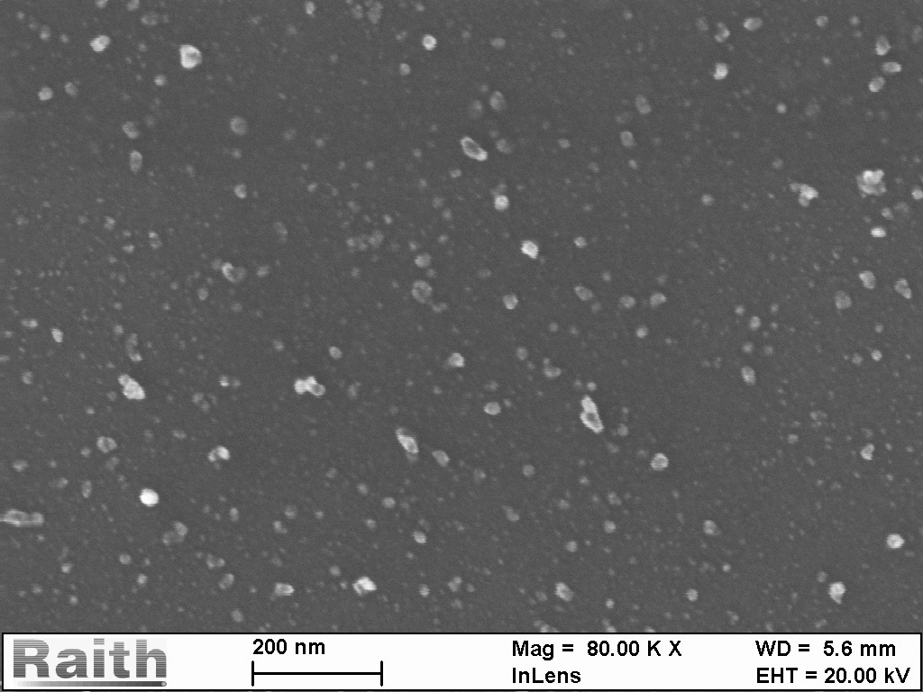
Ni nanoparticles

Slide 31
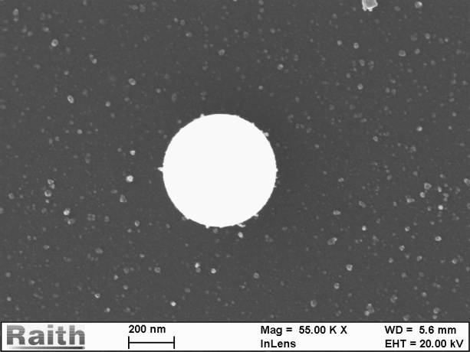
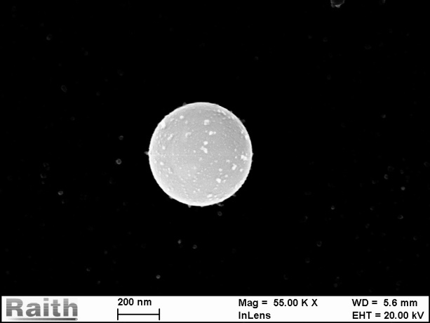
Ni nanoparticles

Slide 32
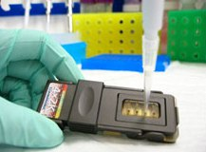
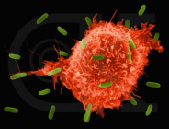
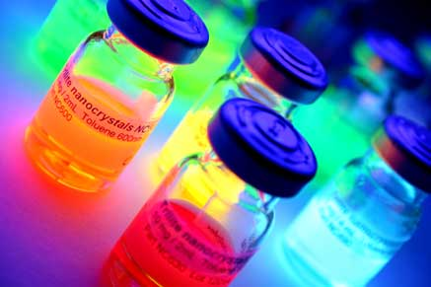
Aplicação das nanoparticulas magnéticas
Cancer treatment
Drug delivery
Nanoparticulas:
Superparamagnetic

Slide 33
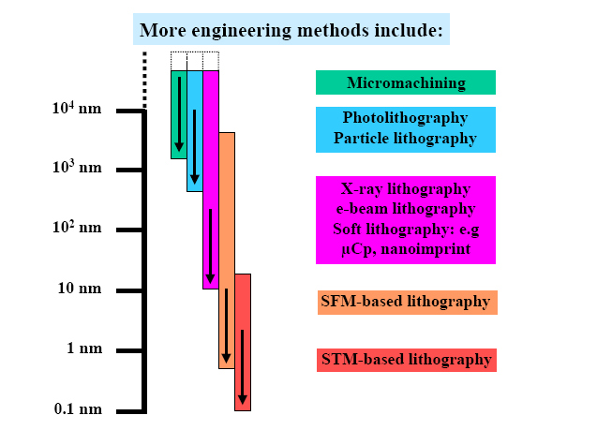
Thin film to nano patterns
33
Notes:
These are the methods to prepare the nano materials. For the research of physics, I would like to focus on the following topics,
33

Slide 34

What is lithography?
34
Notes:
34

Slide 35
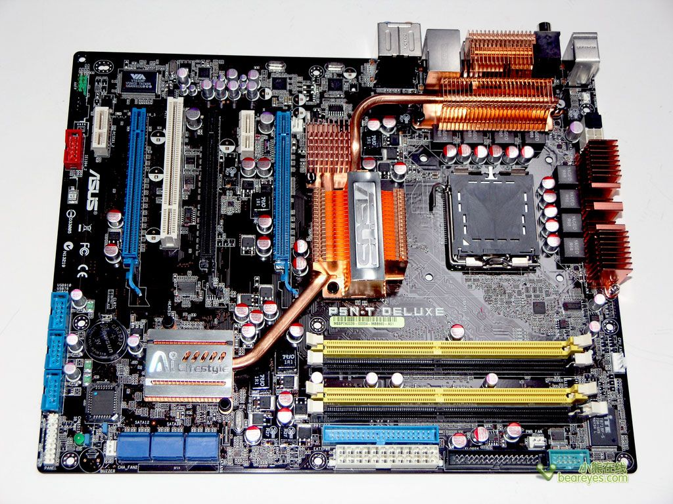
Photolithography
35
Notes:
35

Slide 36
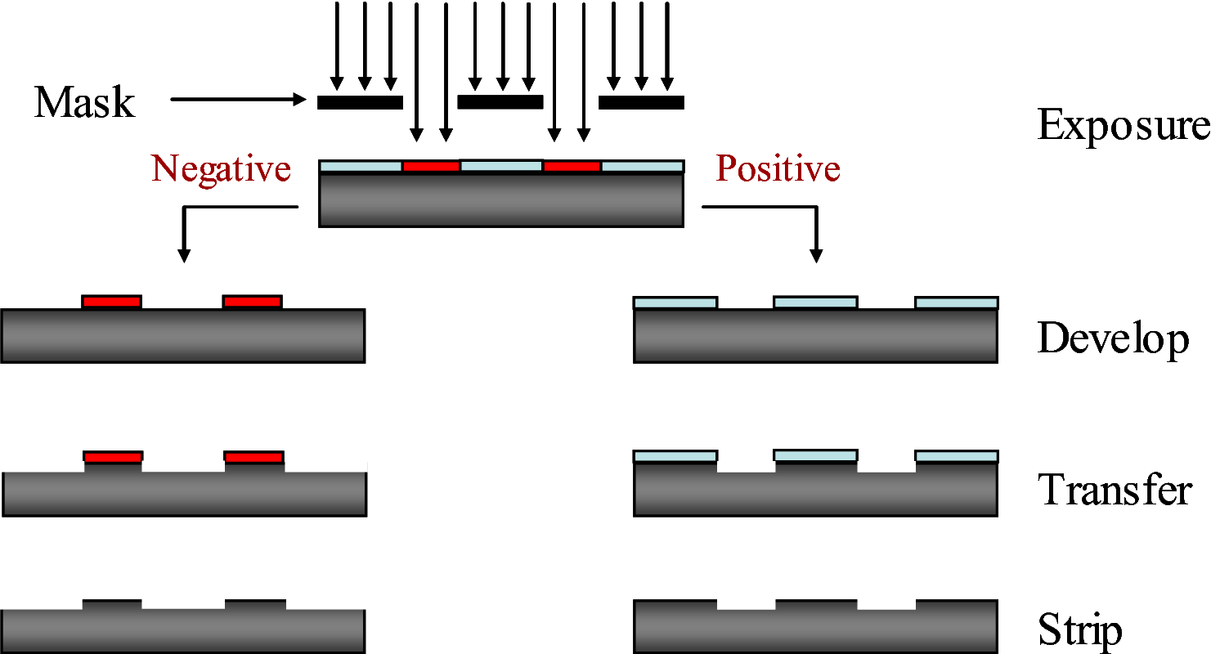
Photolithography
36
Notes:
36

Slide 37
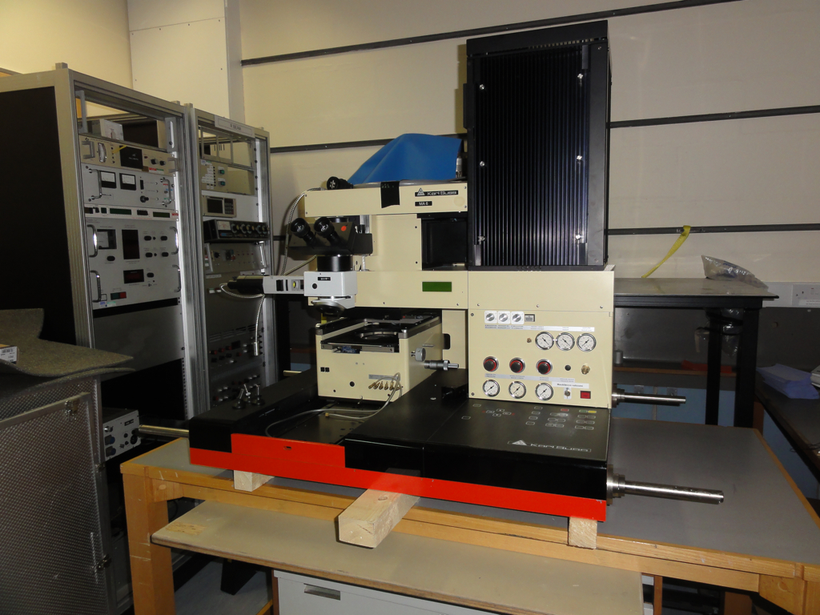
Photolithography
37
Notes:
37

Slide 38
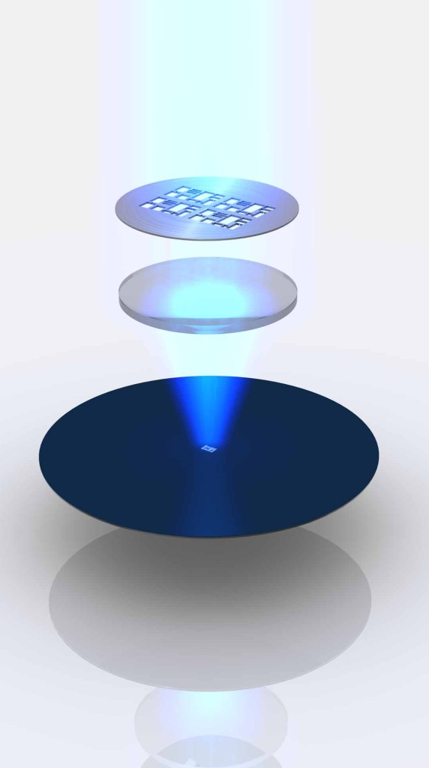
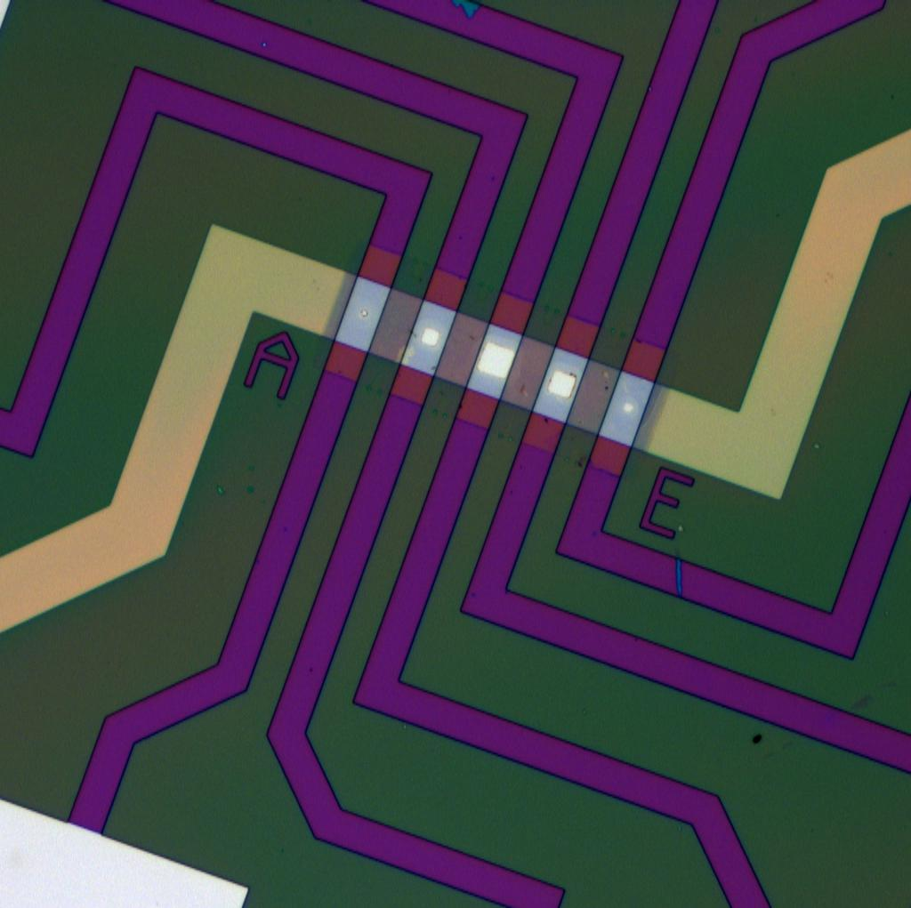
Resolution of Photolithography
Resulution: ~1 μm
38
Notes:
38

Slide 39
E-beam lithography
Question:
How to improve the resolution of lithography?
Rayleigh Criterion: θ_{R} = 1.22 λ/D
Answer:
Use beams with much shorter wave length!
39
Notes:
39

Slide 40
Wavelength of different beams
Visible light:
400 ~ 700 nm
Shoter:
Ultraviolet <400 nm
X-ray 0.01 nm ~ 10 nm
Quantum mechanics:
  λ = h/P
Electron beams: (energy: 10 KeV ~200 KeV)
  λ : 0.002 nm ~ 0.01 nm
40
Notes:
40

Slide 41
Requirements for research with EBL
High quality thin films
  basic requirement, scientific results directly depend on the film quality.
Good EBL
determines the quality of the pattern.
Characterization techniques
  to study the properties of the obtained patterns
  e.g. TEM
41
Notes:
In this case I would like to show the facilities at CBPF which can be used for nanoscience. The first one is
41

Slide 42
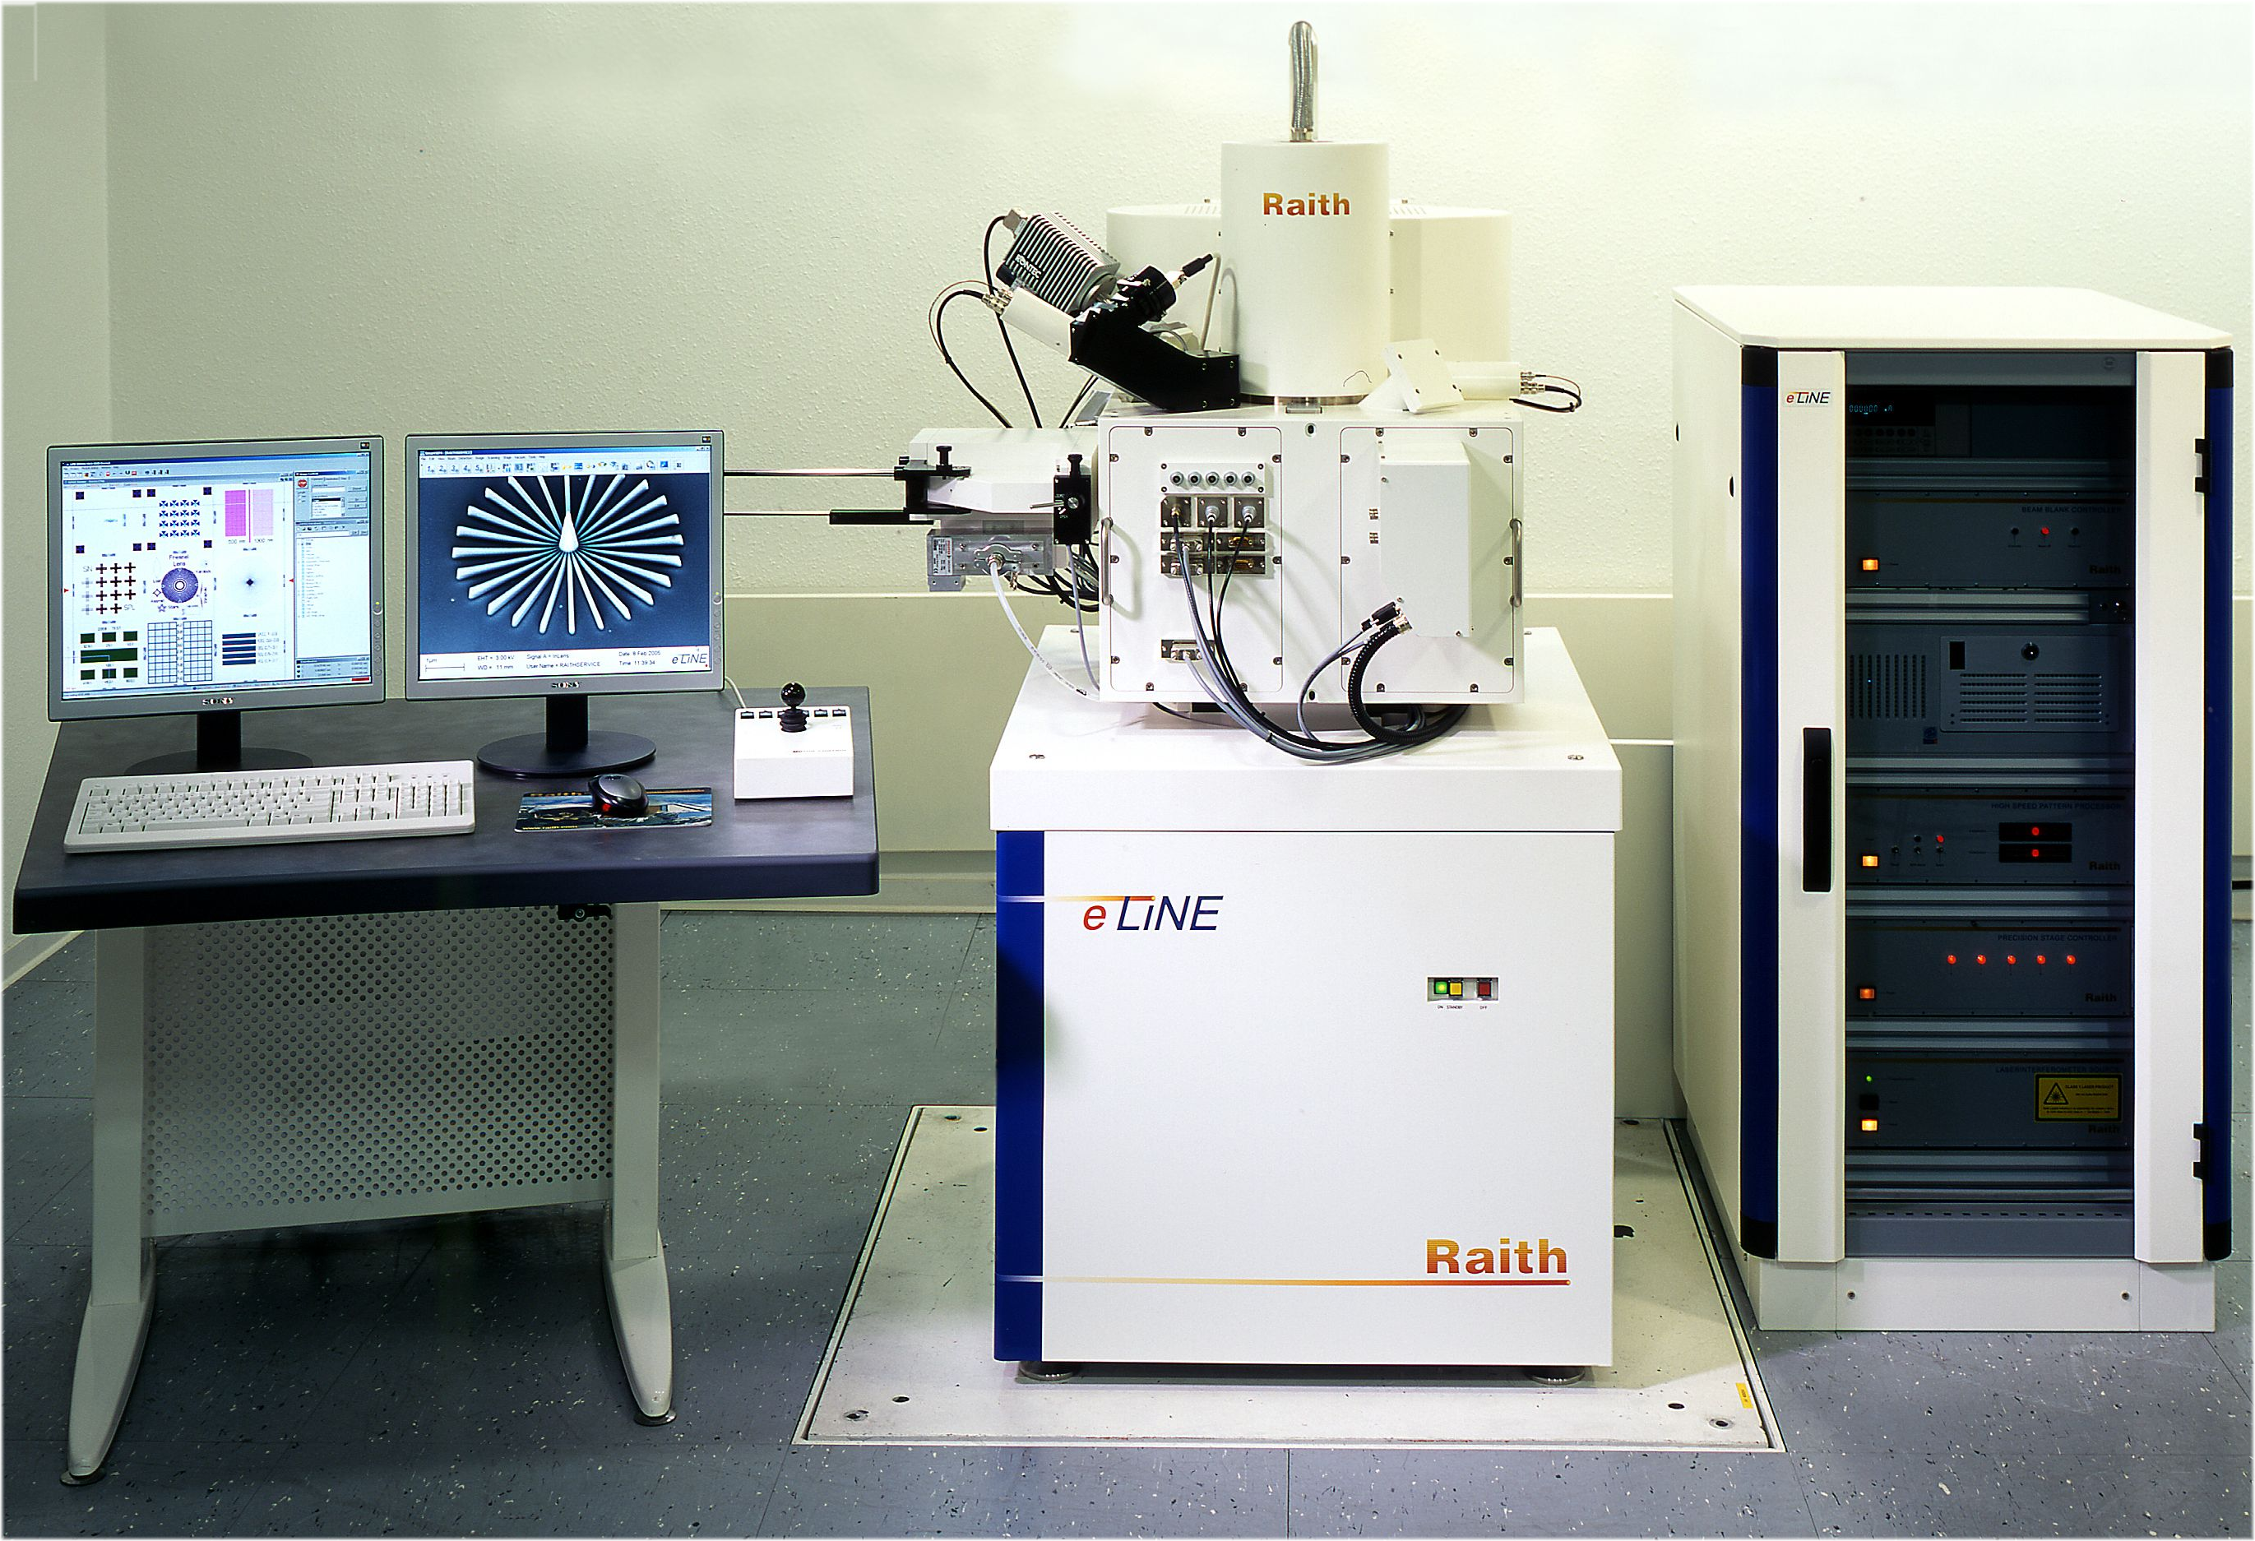
E-beam lithography system
42
Notes:
42

Slide 43
Process of E-beam lithography
Two different processes :
Lift-off (bottum-up)
Etching (top-down)
43
Notes:
43

Slide 44
Etching process
deposition
substrate
substrate
Sample layer
Spin-coating
E-beam
photoresist
substrate
lithography
substrate
etching
remove
substrate
substrate
resist
44
Notes:
44

Slide 45
Lift-off
Spin-coating
substrate
substrate
E-beam
lithography
deposition
substrate
substrate
remove
resist
substrate
45
Notes:
45

Slide 46
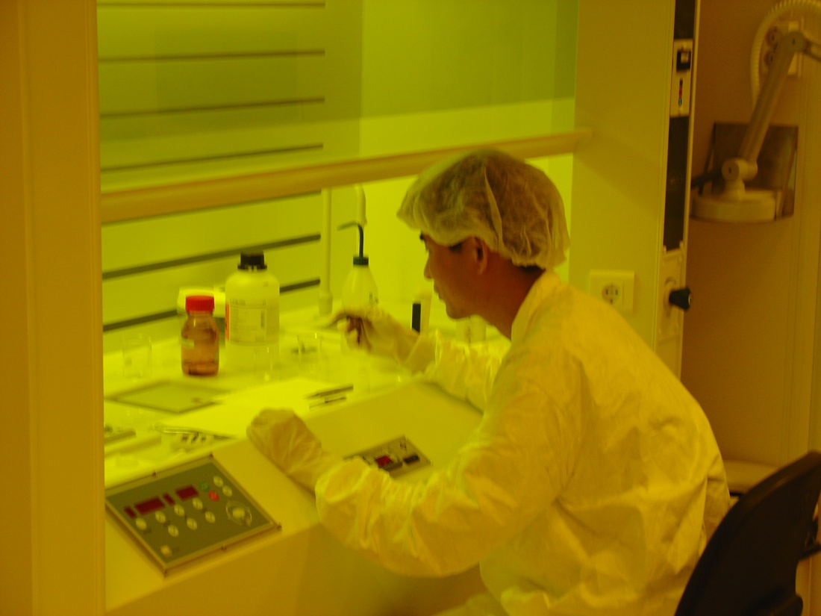

E-beam lithography
→ spin-coating of resist (340 nm thickness)
class 100 clean bench
Notes:
Should say I was working there

Slide 47
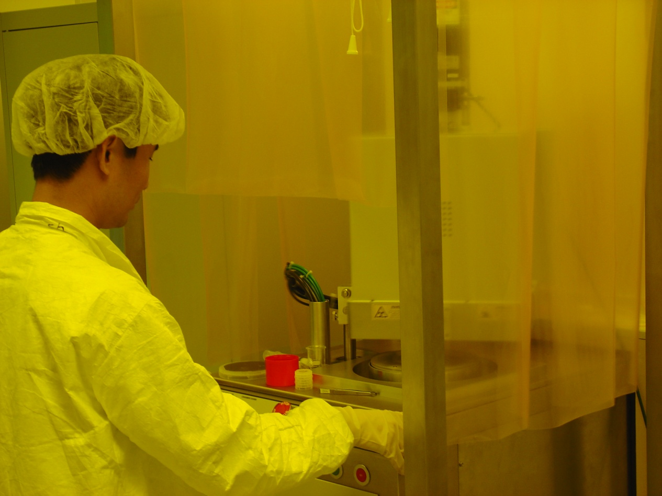
E-beam lithography
→ Ar plasma-etch
Oxford Plasmalab 80+ reactive ion etching system

Slide 48
E-beam lithography
Question:
Positive or negative resist? Why?
Answer:
we have to use LESS machine time!!

Slide 49

EBL need Cleanroom
The dusts in the air are much bigger than the patterns!

Slide 50

EBL need Cleanroom

Slide 51
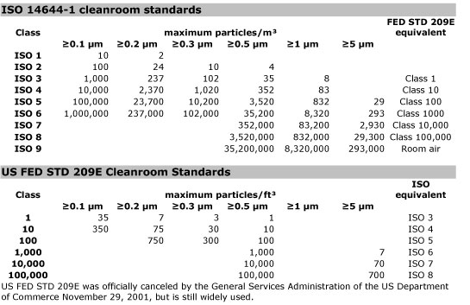
EBL need Cleanroom

Slide 52
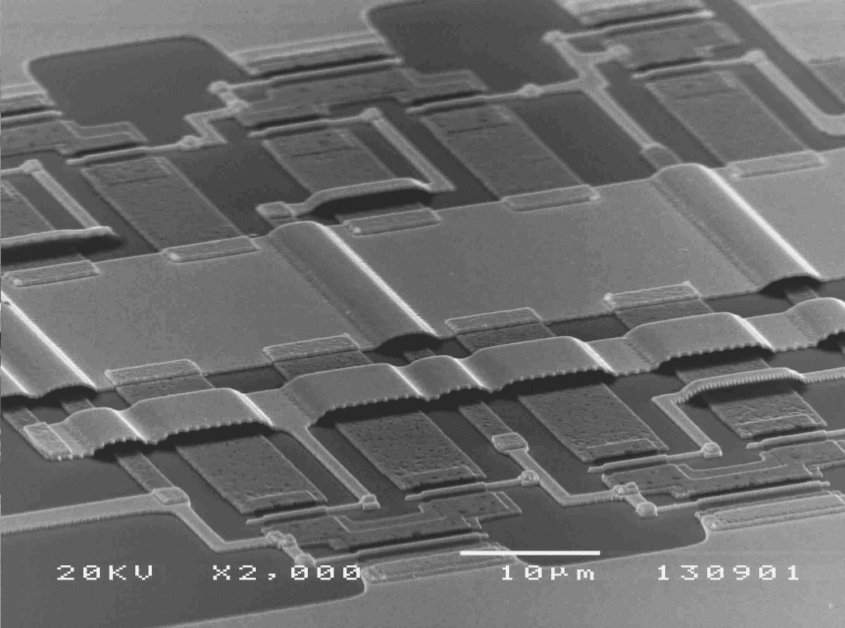
Applications – Electrical Engineering
DEMUX device J. Degenhardt, University of Duisburg, Germany

Slide 53
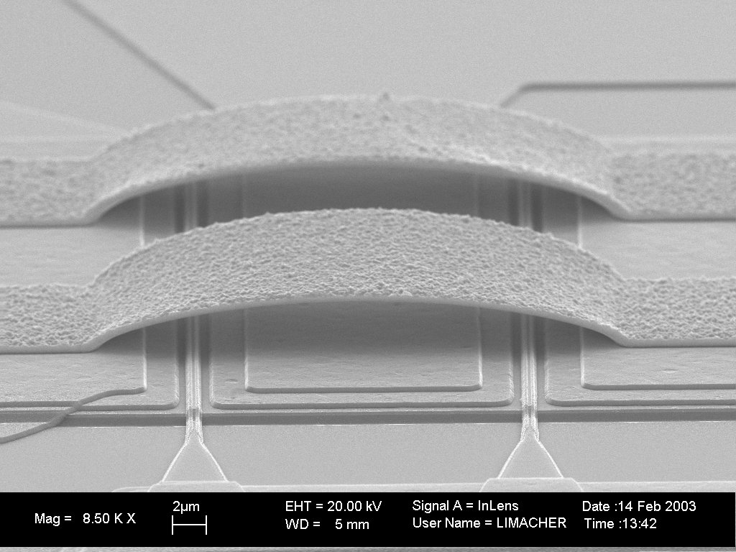
Applications – Electrical Engineering
Applications – Electrical Engineering
Air bridges F. Robin, ETH Zürich, Switzerland

Slide 54
Applications – physics
Applications – Physics
Electrical nm-contact fingers for Carbon Nanotube transport measurement
Adrian Bachthold, University of Basel, Switzerland

Slide 55
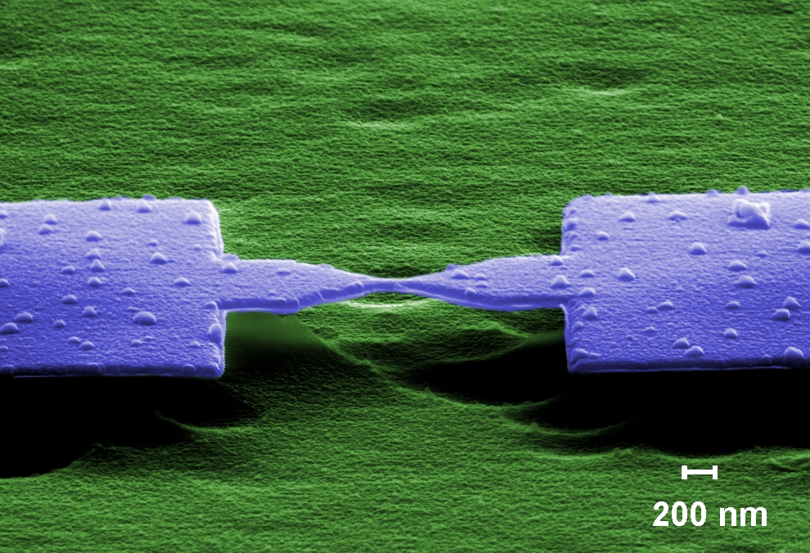
Applications – physics
Al-nanobridge used as a tunneling contact (after mechanical break)
M. Goffman, CEA Saclay, France
E. Scheer, University of Konstanz, Germany

Slide 56
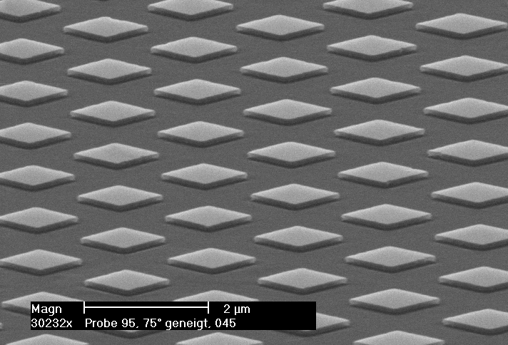
Applications – physics
Applications – Physics
Nanostructure array for Magnetoelectronics
- sub-μ-squares covering 5mm², M. Fraune, Technical University of Aachen, Germany

Slide 57
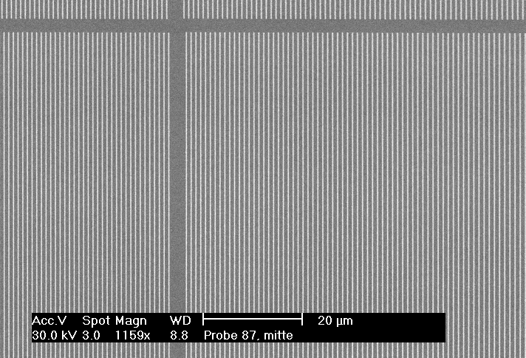
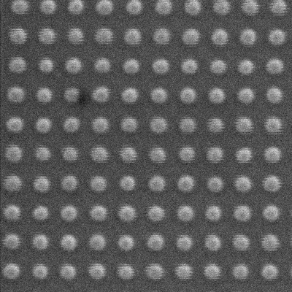
Applications – physics
Applications – Physics
Nanostructure arrays for Magnetoelectronics
- 30nm Quantum dots
University of Bielefeld, Germany
Nanostructure arrays for Magnetoelectronics
- 200nm-lines covering 5mm²
M. Fraune, Technical University of Aachen, Germany)

Slide 58
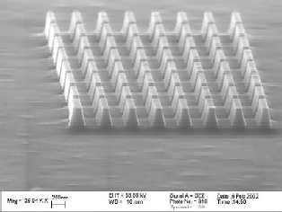
Applications – physics
Applications – Physics
Nano-Structures in ferromagnetic digital alloy
G. Schmidt et al. University of Würzburg, Germany

Slide 59
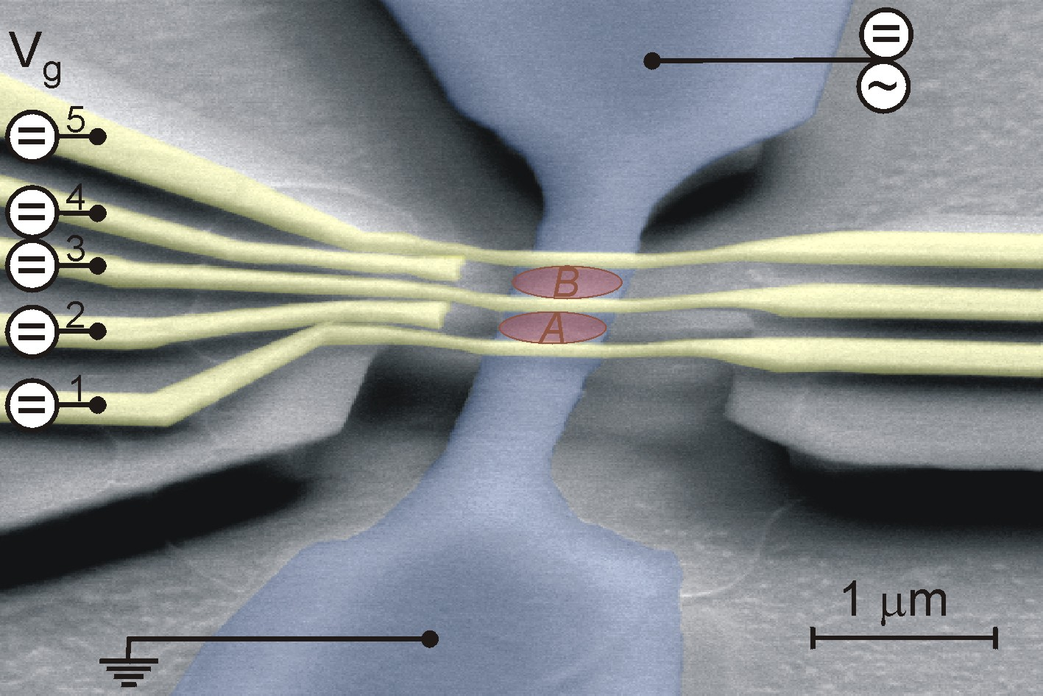
Applications – physics
Applications – Physics
Double Quantum dot structure in free standing GaAs/AlGaAs
E.M. Weig, LMU Munich, Germany

Slide 60

Applications – physics
Applications – Physics
Nano-Hallbar
G. Schmidt et al. University of Würzburg, Germany

Slide 61

Applications – physics
Applications – Physics
Magnetic resonance sensor
G. Schmidt et al., University of Würzburg, Germany

Slide 62


Applications – physics
Applications – Physics
Ballistic transport device
J. Appenzeller, Technical University of Aachen, Germany
Quantum Effects in Superconductor/Hybrid
Devices - Electronic transport studies in
InGaAs/InP heterostructure
J. Appenzeller, Technical University of Aachen, Germany

Slide 63

Applications – Optoelectronics / Optics
Photonic Crystal membrane nano-cavity with InAs quantum dot
as single photon source, Wen-Yen Chen, NCU, Taiwan

Slide 64

Applications – Mater. Science / Process technology
Air bridge fabrication offshoot
„fruit on a table“
Tatjana Borzenko et al.,
University of Würzburg, Germany
Metallic Air Bridge
Tatjana Borzenko et al., University of Würzburg, Germany
Notes:
Clumsy creatures appeared during process development of air bridge!
Siehe pdf Dokument für ausführliche Beschreibung!

Slide 65



Applications – Mater. Science / Process technology
Applications – Mater. Science / Process technology
Replication of structures etched in Si, K. Otte, IOM Leipzig, Germany

Slide 66

Applications – Ultra High Resolution Lithography
Exposure
at 10 keV !
Exposure
at 10 keV !
6 nm
6nm lines exposed in HSQ resist at 10 keV only, D. Lucas, Raith inhouse

Slide 67


Applications – 3D Lithography
Applications – 3D Lithography
Pyramid Retro Reflectors
T. Dillon, University Delaware, USA

Slide 68



Applications – 3D Lithography
Applications – 3D Lithography
3D-Lithography tests for MEMS
T. Dillon, University Delaware, USA

Slide 69
Applications – 3D Lithography
Applications – 3D Lithography
1
2
3
3D-Lithography
1: TIFF-Image 2: AFM-image of 3D-pattern, developped in PMMA
3: 3D-view of AFM-image in 2 to visualize height profile
H. Raith, Raith inhouse

Slide 70

Welcome to join us!

